Slide 1
Housekeeping
Phones in session
Lego Sets
Booklets
Other housekeeping

Slide 2
Playful Reflection with Lego Serious Play
Dr Stephen Dann
@stephendann
Stephen.dann@anu.edu.au

Slide 3
Goals for the session
Discuss sharing understanding for a shared vision
Talk shop about research
Open new lines of discussion
Play with Lego

Slide 4
Why Lego Serious Play?
Roos and Victor (the founders)
Method
Process
Language
Service
Framework
Product
Toolkit
Created at Lego in 1996
Patented in 2001
Victor, B., Roos, J., & Rasmussen, R. (2001). U.S. Patent Application No. 09/772,810.
Open Source in 2010
Two eight-stud LEGO bricks of the same color can be combined in 24 different ways

Slide 5
How it works
Facilitator
Participant
Makes the challenge
Allows time
Controls the process
Assist the discussion
Can assist with the bricks and the assembly
Respond by building a Lego® Model
Own the meaning of your model
Think with your hands
Listen with your eyes
Enjoy the experience
Notes:
Stephen

Slide 6
Shall we begin?

Slide 7
Warmup: The Tower
Build a design that is as tall, elegant and stable as you feel comfortable in making.
Rules
Use the baseplate
Individual builds
Build and rebuild as needed
Observe, learn and share
Experiment with the bricks
1

Slide 8
The Tower
Introduce yourself to your group
Explain the story of your tower.
What is special about your tower, and what makes your tower?

Slide 9
Deconstruction
Revert models to component parts

Slide 10
The Permissions
Permission 1: Permission to Play
LSP often takes participants from a comfort zone to a place of uncertainty

Slide 11
Practice: Metaphors
Purpose driven Lego® building creates visual metaphors
Metaphors communicate complexity
Evoke concepts
Simplify ideas and patterns
Builder assigns the meaning
No one else can tell you what your model means
It is because you say it is.
Cognitive Dissonance

Slide 12
Making a Model
Metaphors communicate complex ideas and expressions that can be difficult to explain in plain words
The Challenge: Bringing life to metaphors
Rules
Select a model from the list
Build the model as illustrated on the guide
The model must look like one on the page
Help from others is allowed
Build in good spirit

Slide 13
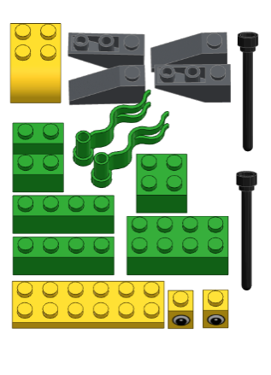
1
2
3
All models rendered in Mecabricks http://www.mecabricks.com/

Slide 14
The builder gives meaning to the model
The Challenge: Bringing life to metaphors
Adjust the model so that the metaphor expresses an answer to the question
What brings happiness to your play?
Rules
Add / delete from the model.
Create a scene if required
You can exaggerate and be dramatic
If you feel stuck – start building
Notes:
A change focused question

Slide 15
Builder owns the meaning of the model
Clarification may be sought as to the meaning of a brick, colour or a motif
Explanations can range in depth and insight
It’s always fair to say “I like the brick” or “It’s the only brick I could find”
If you weren’t told the story was “Helping others up”, how did you see the model?
Notes:
Reiterate that you can hide behind the bricks. Safety is paramount

Slide 16
The builder gives meaning to the model
The Challenge: Bringing life to metaphors
Using your model, explain to the other group members
“What brings happiness to your play?”
Rules
Listen with your eyes
Ask questions of the model
The builder owns the meaning
Point to elements of the model as you tell your story

Slide 17
Deconstruction
Photo op!

Slide 18
The Permissions
Permission 2: Permission to Own
Turning the existing into the meaningful through taking (temporary/virtual) ownership

Slide 19
Projection: Brick Collages
Select either Set A or Set B
Select an additional 10 bricks
Chose bricks that appeal to your eye or feel right in your hand
Trust your first impressions
Notes:
Exercise Slide

Slide 20
Core bricks plus 10 more
Set A
Set B

Slide 21
Build Challenge
Using the 15 bricks, build a model to explain an answer to…
“What is one new thing that I have learnt from Playful Learning 2019 so far?”
Rules
Trust your hands
Builder owns the meaning of the model
If you feel stuck – start building
2

Slide 22
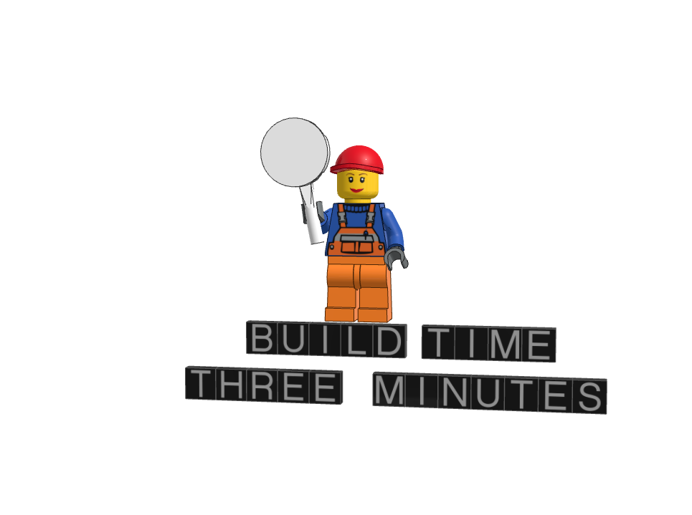
Goals to Outcomes
Project Challenge:
Set the previous model aside
Use the remaining pieces to create a model that you can use to explain an answer to the question
“How can I use this new idea in the next few weeks?”
Rules
Exaggeration, drama and humor can help
If you feel stuck – start building
Use as much or as little of the kit as you want
Nothing off the first model though
3
Notes:
Application Exercise

Slide 23
Sharing the models
Using both models, share your story of what you have learnt, and how you will use that new idea
Rules
Listen with your eyes
Ask questions of the model
The builder owns the meaning
Listen for commonality and divergence

Slide 24
Document and Capture

Slide 25
Deconstruction
Second last time…

Slide 26
The Permissions
Permission 3: Permission to Use
Payload Exercises
Taking function through fun
Play with a purpose

Slide 27
Universal Build: Select these pieces

Slide 28
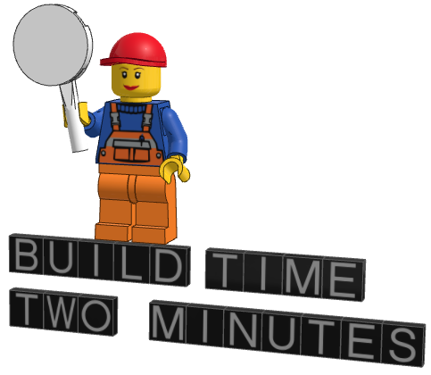
The Challenge
Using only those selected pieces…
Build a model to help explain to your groupmates, your experience of this workshop
Rules
If you feel stuck – start building
Put pieces together, let the story come to you
Build to explain to your table mates
2
Notes:
Application Exercise

Slide 29
Sharing the models
Using the model, explain your experience of the workshop to your table mates
Rules
Listen with your eyes
Ask questions of the model
The builder owns the meaning
Note the commonality and the divergence
Story stops, questions start

Slide 30
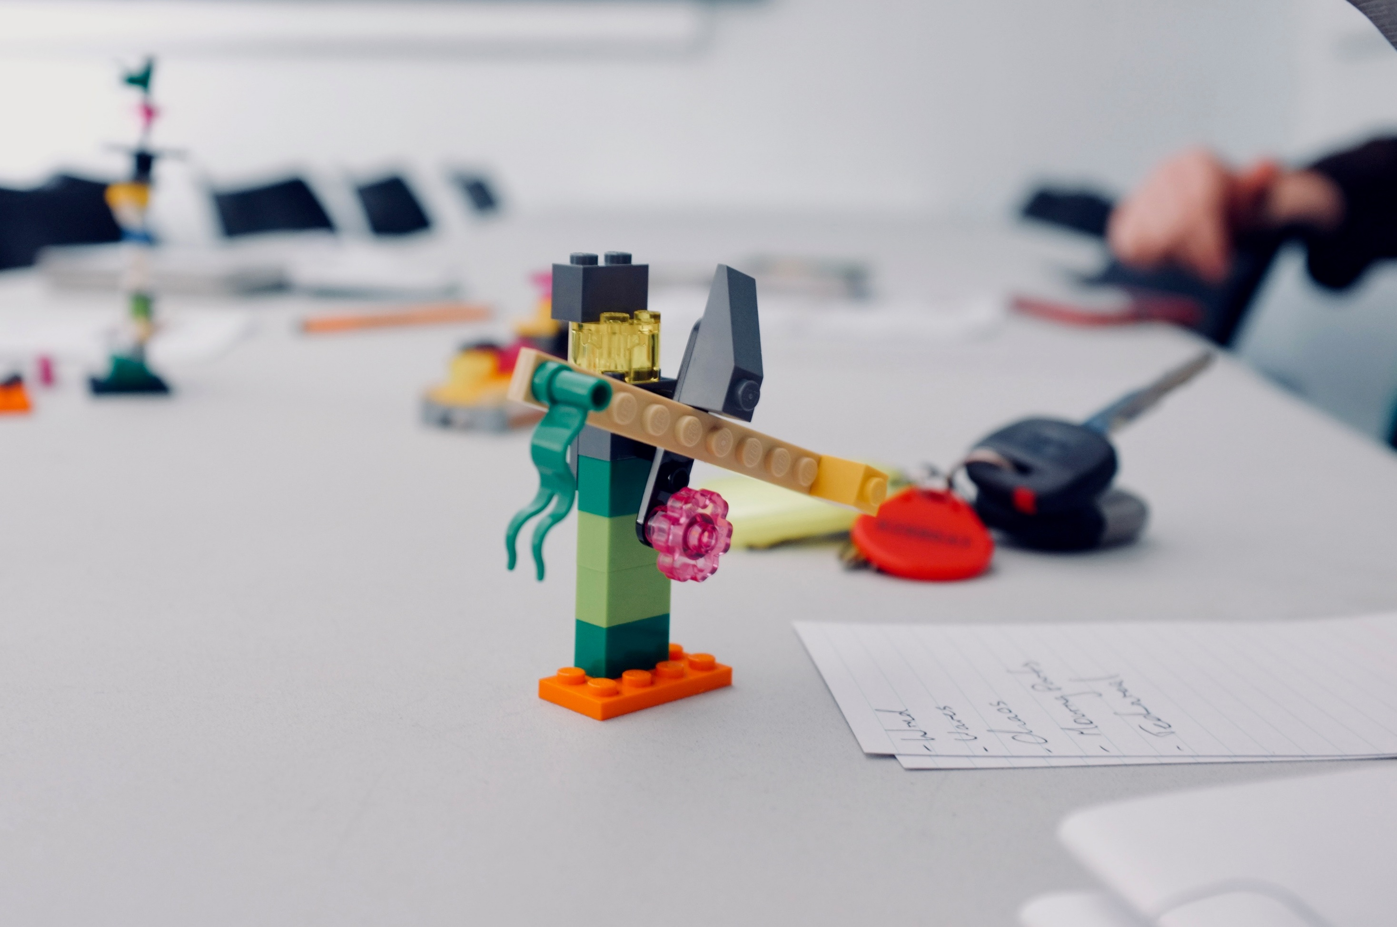
Debrief

Slide 31
Quick look around for missing pieces

Slide 32
Dann, S. (2018). Facilitating co-creation experience in the classroom with Lego Serious Play. Australasian Marketing Journal (AMJ), 26(2), 121-131.

Slide 33
ANU Research School of Management
Stephen.dann@anu.edu.au
www.rsm.anu.edu.au

