Slide 1
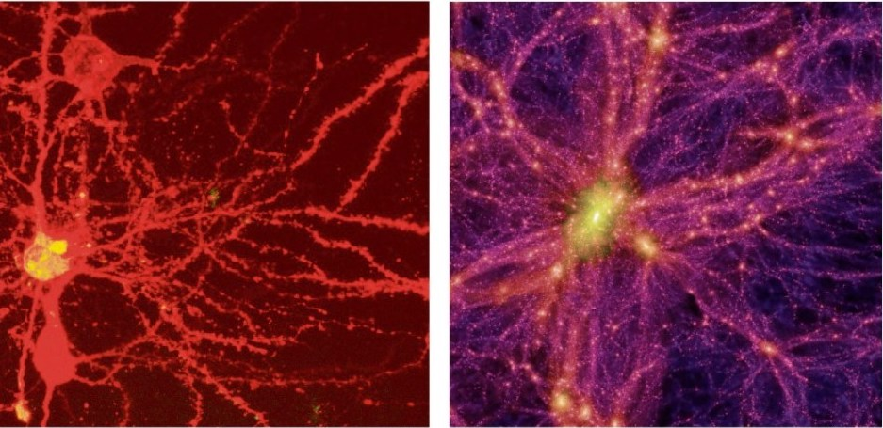
Notes:
Left: neurons
Right: a simulation of all known Universe

Slide 2
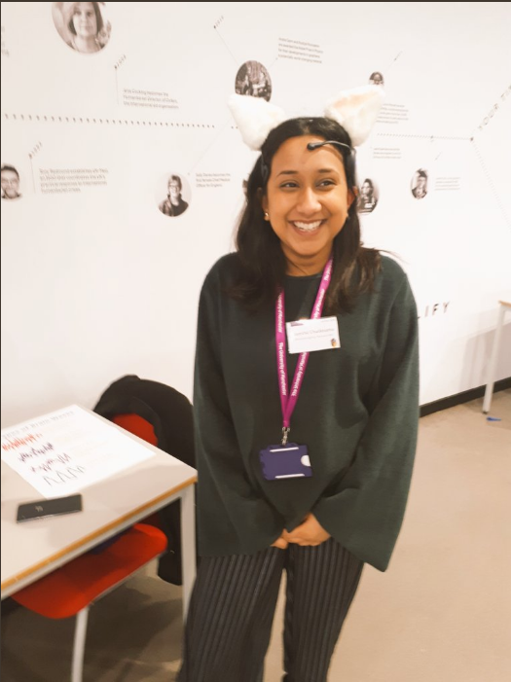
Cognitive Neuroscience of Memory and Language
Notes:
Carmen (left), 3rd year PhD student, investigating recognition memory and how we can influence people’s memory judgements, using EEG
Jayesha (right), 2nd year PhD student, investigating the neural basis of language, using TMS and fMRI

Slide 3
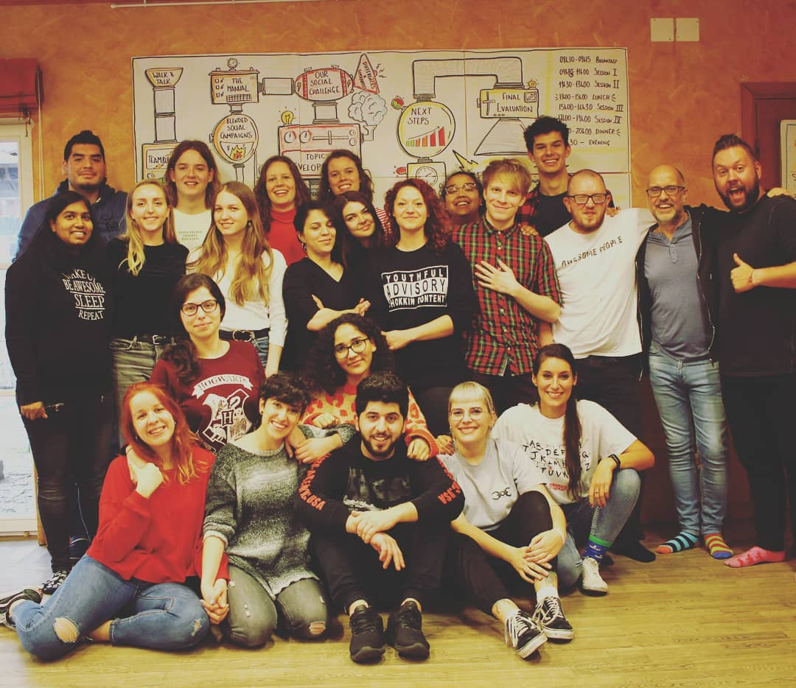
Notes:
Shokkin Group International is a network of youth organizations in Europe working together to contribute to social and civic development of young people and support each other to provide high quality services. Carmen = board member of the network; this is where the inspiration to create educational games came from.
https://shokkin.org

Slide 4
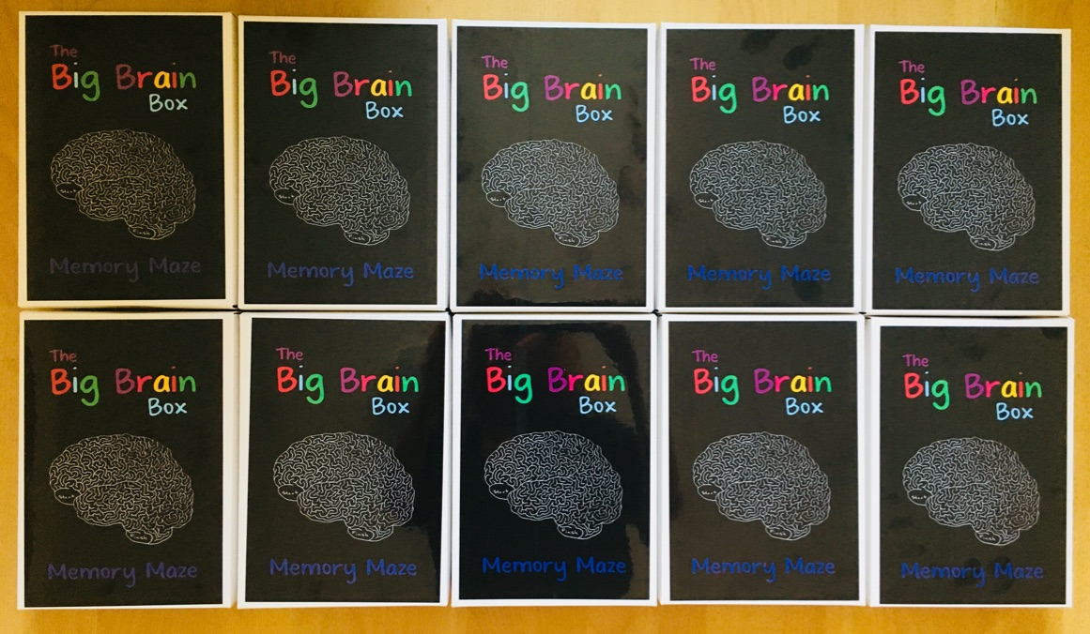
The Big Brain Box – Memory Maze
Hello!
Notes:
The Big Brain Box was created for a public engagement event (called Big Brain Summer School), its printing being funded through a small Wellcome Trust grant.
Concept: Carmen
Visuals: Jayesha

Slide 5
The Big Brain Box – Memory Maze
Beta version..
Science communication tool
13+
Played with 150+ students
Notes:
After its success during the Big Brain Summer School, the game has been used with more than 100 school students interested in Science.

Slide 6
Learning objectives
Knowledge: what is episodic memory and some concepts related to brain research
Skills: problem solving, attention to details, teamwork, creativity
Attitude: that we do not have all the answers

Slide 8
Take home message 1
By playing the game you developed important skills:
Attention to detail
Problem solving
Creativity
Team work

Slide 9
Take home message 2
We don’t have all the answers about the human brain, for example déjà vu is still a mystery..

Slide 10
Thank you! Carmen Ionita @carmen_ionita Jayesha Chudasama @jayesha_chu Shokkin Group International: shokkin.org

